Slide 1
Fundamentals of Psychology
Chapter # 2 PSYCHOLOGICAL RESEARCH
Sadia Qazi
Sadia.qazi@@ucp.edu.pk

Slide 2

Why is research important?
At one time in history, people believed the earth was flat and that mental illnesses were caused by possession.
People can be very wrong in their ideas about the world when they do not rely on evidence to support their claims.
Research is a mandatory process in validating claims.
Scientific research is empirical; it is grounded in objective, tangible evidence that can be observed time and time again, regardless of who is observing.
Without research, we would only have intuition and groundless assumptions.
Through research we are able to prove certain ideas through study and testing.
Psychology is a science, therefore, research is required to not only further investigate something but provide verification and support of the findings.
Figure 2.2 Some of our ancestors, across the world and over the centuries, believed that trephination—the practice of making a hole in the skull, as shown here—allowed evil spirits to leave the body, thus, curing mental illness and other disorders.

Slide 3
Use of research information
Advertising campaigns often claim to be based on “scientific evidence” when in reality it is based off of belief.
Thinking critically about claims:
What is the expertise of the person making the claim?
What might they gain if the claim is valid?
Does the claim seem justified given the evidence?
What do other researchers think of the claim?

Slide 4
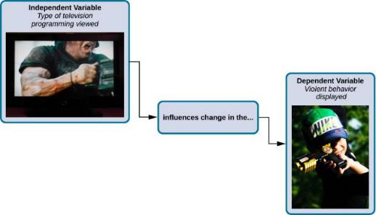
variables
Independent Variable – Variable that is influenced/controlled by the experimenter. Ideally this should be the only important difference between the experimental and control group.
Dependent Variable – Variable that the researcher measures to see how much effect the independent variable had.
In an experiment, manipulations of the independent variable are expected to result in changes in the dependent variable.

Slide 5
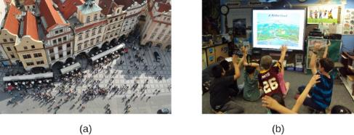
Selecting participants
Participants – Subjects of psychological research.
Population – overall group of individuals that the researcher is interested in (e.g. College students).
Populations are too large for a researcher to include everyone so samples are used.
Sample - subset of individuals selected from the larger population.
Random Sample - subset of a larger population in which every member of the population has an equal chance of being selected.
This form of sampling is preferred because it is more likely that the selected participants will be representative of the larger population (sex, ethnicity, social economic status etc).
Researchers may work with (a) a large population or (b) a sample group that is a subset of the larger population.

Slide 6
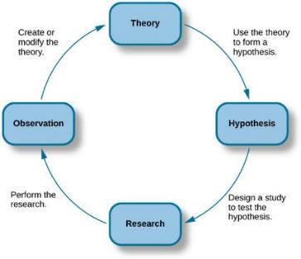
The scientific method
Theory – well-developed set of ideas that propose an explanation for observed phenomena.
Hypothesis – tentative and testable statement (prediction) about the relationship between two or more variables.
Predicts how the world will behave if the theory is correct.
Usually an “if-then” statement.
Is falsifiable (capable of being shown to be incorrect).
The scientific method of research includes proposing hypotheses, conducting research, and creating or modifying theories based on results.

Slide 7
2.2 Approaches to research
Clinical or case studies
Experimental Research
Naturalistic Observation
Surveys
Archival Research
Longitudinal and Cross-Sectional Research

Slide 8
Clinical or case studies
Clinical or case studies focus on one individual.
The studied individual is typically in a extreme or unique psychological circumstance that differentiates them for the general public.
Allows for a lot of insight into a case.
Difficult to generalize results to the larger population.
Example: Genie
Genie was studied by psychologists after she was found at age 13, having suffered severe abuse and social isolation. Psychologists were interested in the effect social isolation had on her development.
(Credit: Captive Humans)

Slide 9
Observational Research
Observational research is a research technique where you observe participants and phenomena in their most natural settings. This enables researchers to see their subjects make choices and react to situations in their natural setting, as opposed to structured settings like research labs or focus groups.
Covert observations are when the researcher pretends to be an ordinary member of the group and observes in secret. There could be ethical problems or deception and consent with this particular method of observation.
Overt observations are when the researcher tells the group he or she is conducting research (i.e. they know they are being observed).

Slide 10
Controlled: behavior is observed under controlled laboratory conditions (e.g. Bandura's Bobo doll study).
Natural: Here spontaneous behavior is recorded in a natural setting.
Participant: Here the observer has direct contact with the group of people they are observing.
Non-participant (aka "fly on the wall): The researcher does not have direct contact with the people being observed.

Slide 11

Naturalistic Observation
Observation of behavior in its natural setting.
Naturalistic behavior is generally hidden under scrutiny or observation.
Seeing a police car behind you would probably affect your driving behavior.
To study the most accurate and genuine behaviors, naturalistic observation has proven most effective.
Through naturalistic observations, any feeling of performance or anxiety of the studied individuals is eliminated.
Observer bias - when observations may be skewed to align with observer expectations.
Establishment of clear criteria to observe should help eliminate observer bias.
Seeing a police car behind you would probably affect your driving behavior. (credit: Michael Gil)

Slide 12
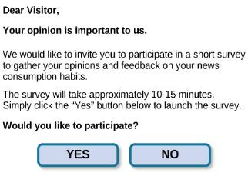
surveys
A list of questions that can be delivered in many ways:
Paper-and-pencil
Electronically
Verbally
Surveys can be used to gather a large amount of data from a sample (subset of individuals) from a larger population.
Surveys can be administered in a number of ways, including electronically administered research, like the survey shown here. (credit: Robert Nyman)

Slide 13

Archival research
Uses past records or data sets to answer various research questions, or to search for interesting patterns or relationships.
A researcher doing archival research examines records, whether archived as a (a) hardcopy or (b) electronically.

Slide 14
Causality: conducting experiments & using the data
The only way to establish that there is a cause-and-effect relationship between two variables is to conduct a scientific experiment.
A scientific experiment has precise requirements for design and implementation.
THE EXPERIMENTAL HYPOTHESIS
Hypotheses can be formulated through:
Observation
After review of previous research

Slide 15
Experimental Research
Experimental research investigating the relationship between two (or more) variables by deliberately producing a change in one variable in a situation (experimental manipulation) and observing the effects of that change on other aspects of the situation.
Experimental group: Any group participating in an experiment that receives a treatment.
Control group: A group participating in an experiment that receives no treatment.
Example: aggression is caused by the TV viewing

Slide 16
Lab Experiment This type of experiment is conducted in a well-controlled environment – not necessarily a laboratory – and therefore accurate and objective measurements are possible.
Field Experiment
These are conducted in the everyday (i.e. natural) environment of the participants but the situations are still artificially set up.
Natural Experiment
Natural experiments are when a naturally occurring IV is investigated that isn’t deliberately manipulated, it exists anyway. Participants are not randomly allocated and the natural event may only occur rarely.

Slide 17
Designing an experiment
EXPERIMENTAL AND CONTROL GROUPS
Experimental group - The participants that experience the manipulated variable (group designed to answer the research question).
Control group - Participants that do not experience the manipulated variable.
Serve as a basis for comparison and controls for chance factors that might influence the results of the study
Experimental manipulation is the only difference between the experimental and control groups, so any differences between the two are due to experimental manipulation rather than chance.
DEFINING VARIABLES AND HOW THEY WILL BE MEASURED
Operational definition - description of what actions and operations will be used to measure the dependent variables and manipulate the independent variables.

Slide 18
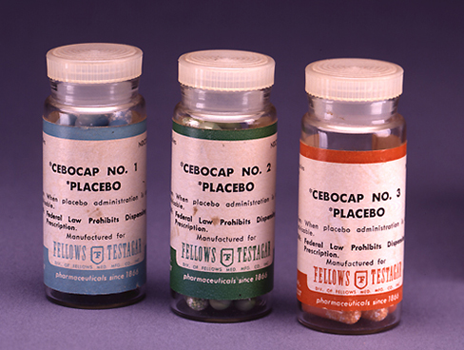
Figure 2.16
Providing the control group with a placebo treatment protects against bias caused by expectancy. (credit: Elaine and Arthur Shapiro)

Slide 19
Assigning participants to groups: experimental or control
Random Assignment – Method of experimental group assignment in which all participants have an equal chance of being assigned to either group.
Can be achieved using statistical software or by simply flipping a coin.
Prevents systematic differences between groups such as gender or age.
Without random assignment, an experiment cannot find a true cause-and-effect relationship. Any relationship could be due to preexisting differences between the groups.
Random assignment helps to avoid preexisting systematic differences so that any significant differences between groups can be said to be the result of the manipulation.

Slide 20
How Experimental Research Is Done
Step | Description | Example (Computer Science)
1. Identify the Problem | Decide what you want to study. | “Does changing button color affect click rate?”
2. Form a Hypothesis | Make a prediction. | “A red button will get more clicks than a blue one.”
3. Select Variables | - IV: what you change - DV: what you measure - Controls: what you keep constant | - IV: Button color - DV: Number of clicks - Controls: Same text, position, size
4. Choose Participants | Select and randomly assign people to groups. | Split users randomly into two groups (Group A sees red button, Group B sees blue).
5. Conduct the Experiment | Give each group the conditions and collect data. | Users interact with the website for 10 minutes.
6. Analyze the Data | Compare results to see if the change made a difference. | Count how many times each button was clicked.
7. Draw Conclusions | Accept or reject the hypothesis. | If red got more clicks, color affects user behavior.

Slide 21
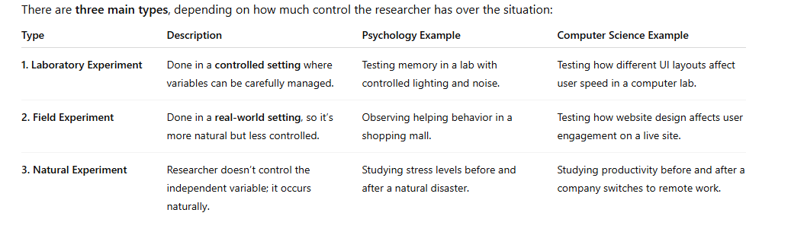
Types of Experimental Research

Slide 22
💡 Why It’s Important (Especially for CS Students)
Helps test software, interfaces, or algorithms scientifically
Useful in user experience (UX) design, A/B testing, and AI evaluation
Encourages evidence-based decision-making instead of guessing
Builds skills in data analysis and critical thinking

Slide 23
Ethics in Research
1. Informed Consent
This means participants must be fully informed about the purpose, methods, risks, and benefits of the study or activity before agreeing to take part. They should understand what they are agreeing to and give their consent freely, usually in writing.
Example: Before joining a medical study, participants are told about possible side effects and what procedures will be done.
2. Voluntary Participation
Participation must be completely voluntary, people should not be forced, pressured, or tricked into taking part. They should also have the right to withdraw at any time without any negative consequences.
Example: A student taking part in a survey should be free to stop answering questions if they feel uncomfortable.
3. Do No Harm
Researchers and professionals must ensure that no physical, emotional, or psychological harm comes to participants as a result of the study. This includes avoiding stress, embarrassment, or danger.
Example: If a study topic could cause emotional distress, researchers should provide support or counseling resources.

Slide 24
Ethics in Research
4. Confidentiality
This means that personal information shared by participants must be kept private and secure. Only the research team (or authorized people) should have access to identifying information.
Example: A researcher does not share a participant’s name or responses with anyone outside the study team.
5. Anonymity
Anonymity goes a step further than confidentiality, it means that the researcher does not even know who the participants are. No names or identifying details are collected, so responses cannot be linked to specific people.
Example: An anonymous online survey where no names or emails are recorded.
6. Plagiarism
Plagiarism means using someone else’s words, ideas, or work without proper acknowledgment and presenting them as your own. It is a serious ethical violation in research, writing, and academics.
Example: Copying text from a website or another student’s paper without citing the source is plagiarism. To avoid it, you should: Always use quotation marks for direct quotes. Paraphrase ideas in your own words. Provide proper citations and references.

